Slide 1

Toolkit Doc2 Bottom Front/Rear Panels
April 12, 2010

Slide 2
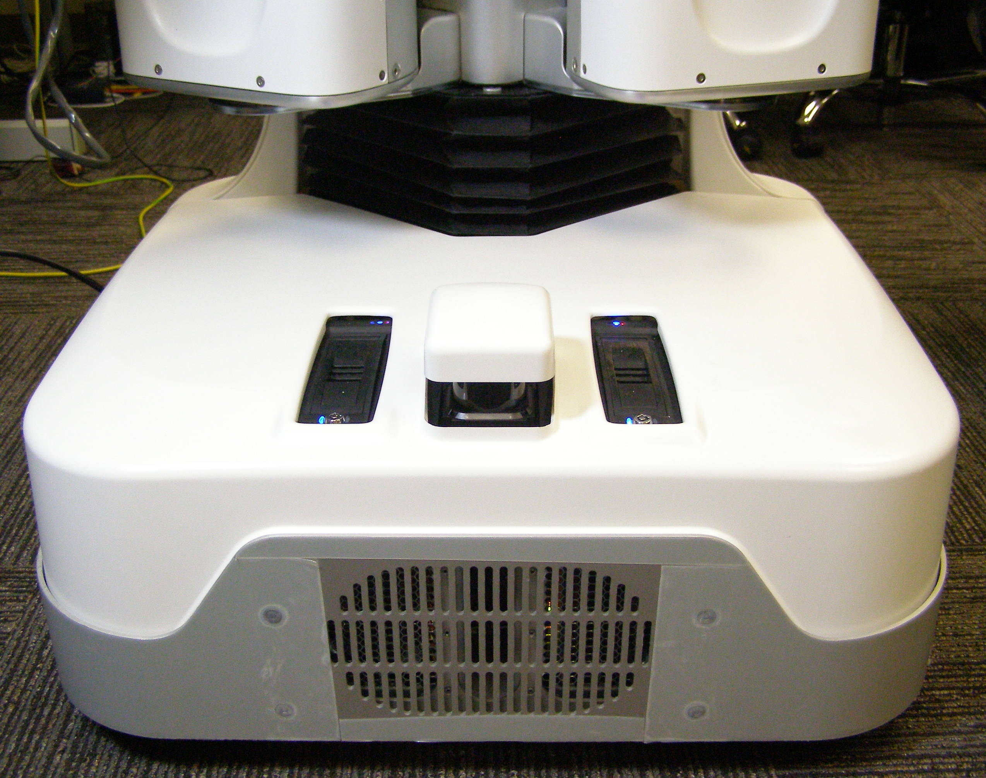
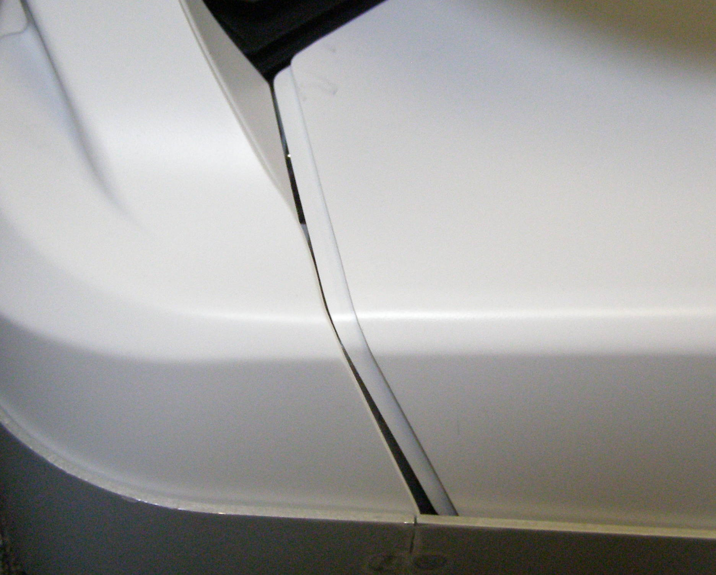
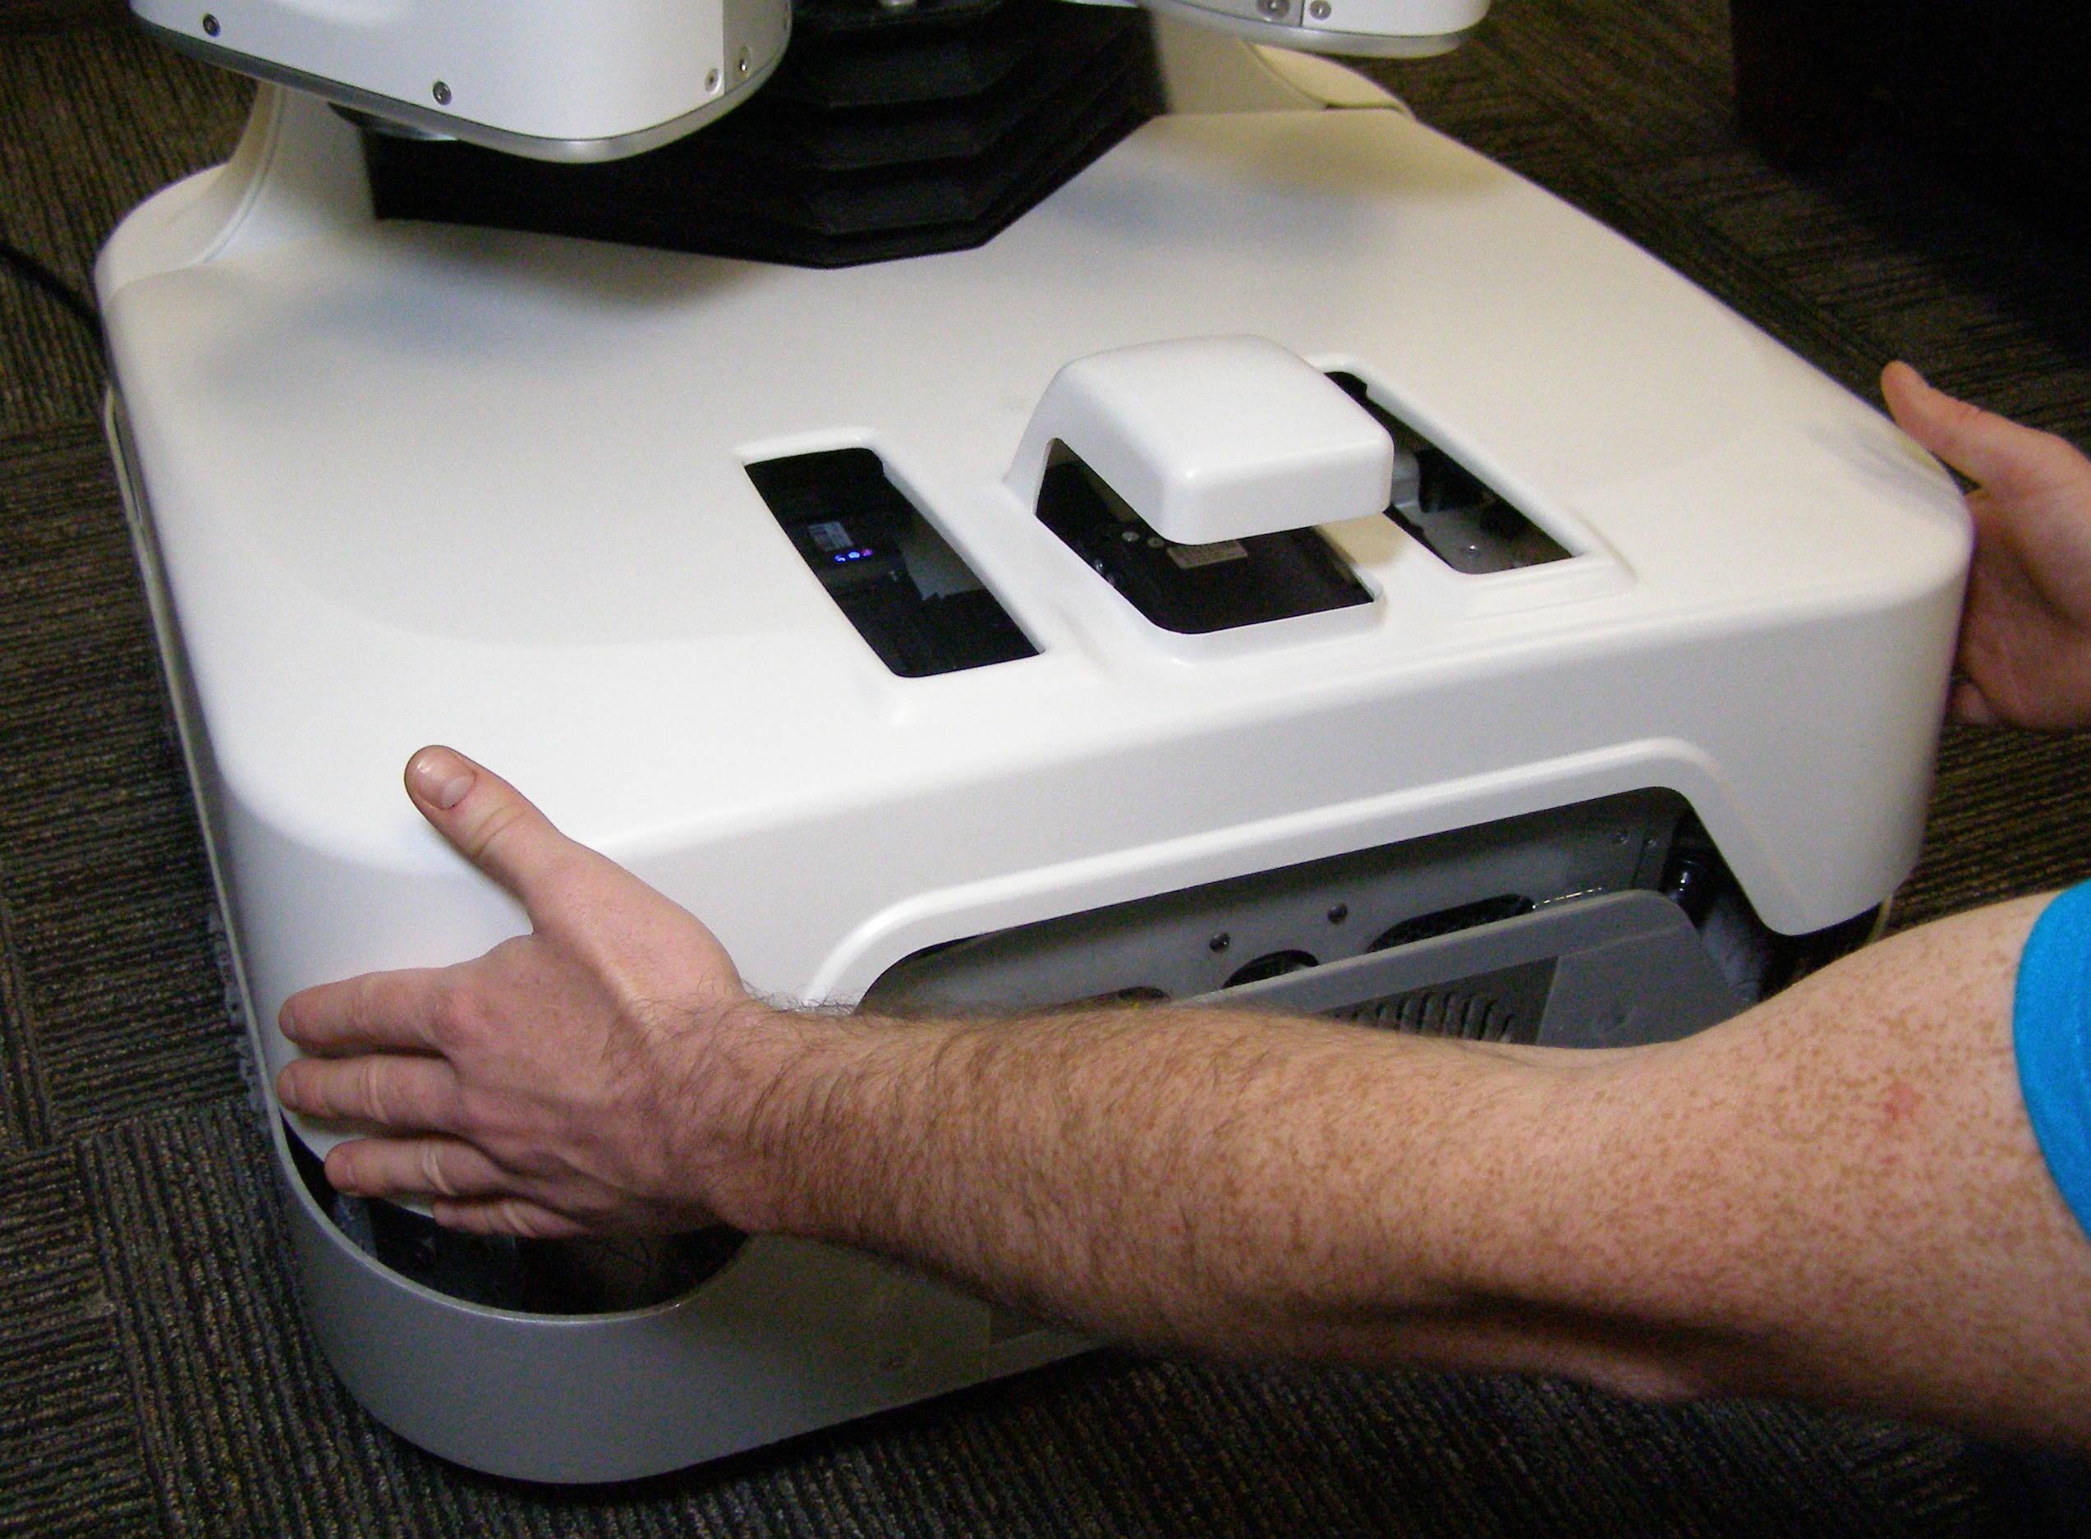
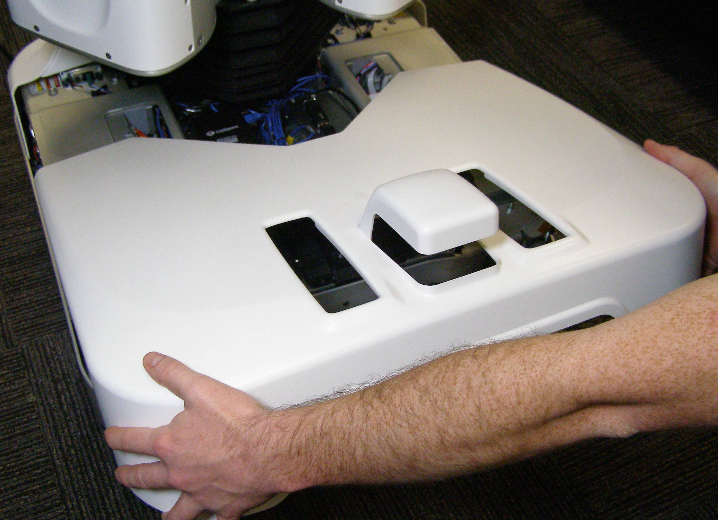
  Front Bottom Panel R/R
Front Bottom Panel, Removal – 2174
  Raise the Spine at least 5cm. (Fig 1)
  Clasp the front of the Panel on each side. (Fig 2)
  Lift the front of the Panel straight up until it clears the Hokuyo.
  Slide the Panel forward about 30cm and lift it from the Robot. (Fig 3)
Front Bottom Panel, Install
  Starting 30cm back, slide the Panel towards the rear making sure that it clears the Hokuyo.
  Make sure the Panel is all the way back and slips under the Rear Bottom Panel edge. (Fig 4)
  Lower the front within the confines of the bumpers. (Fig 1)
Fig 1
Fig 4
Fig 2
Hokuyo
Fig 3

Slide 3
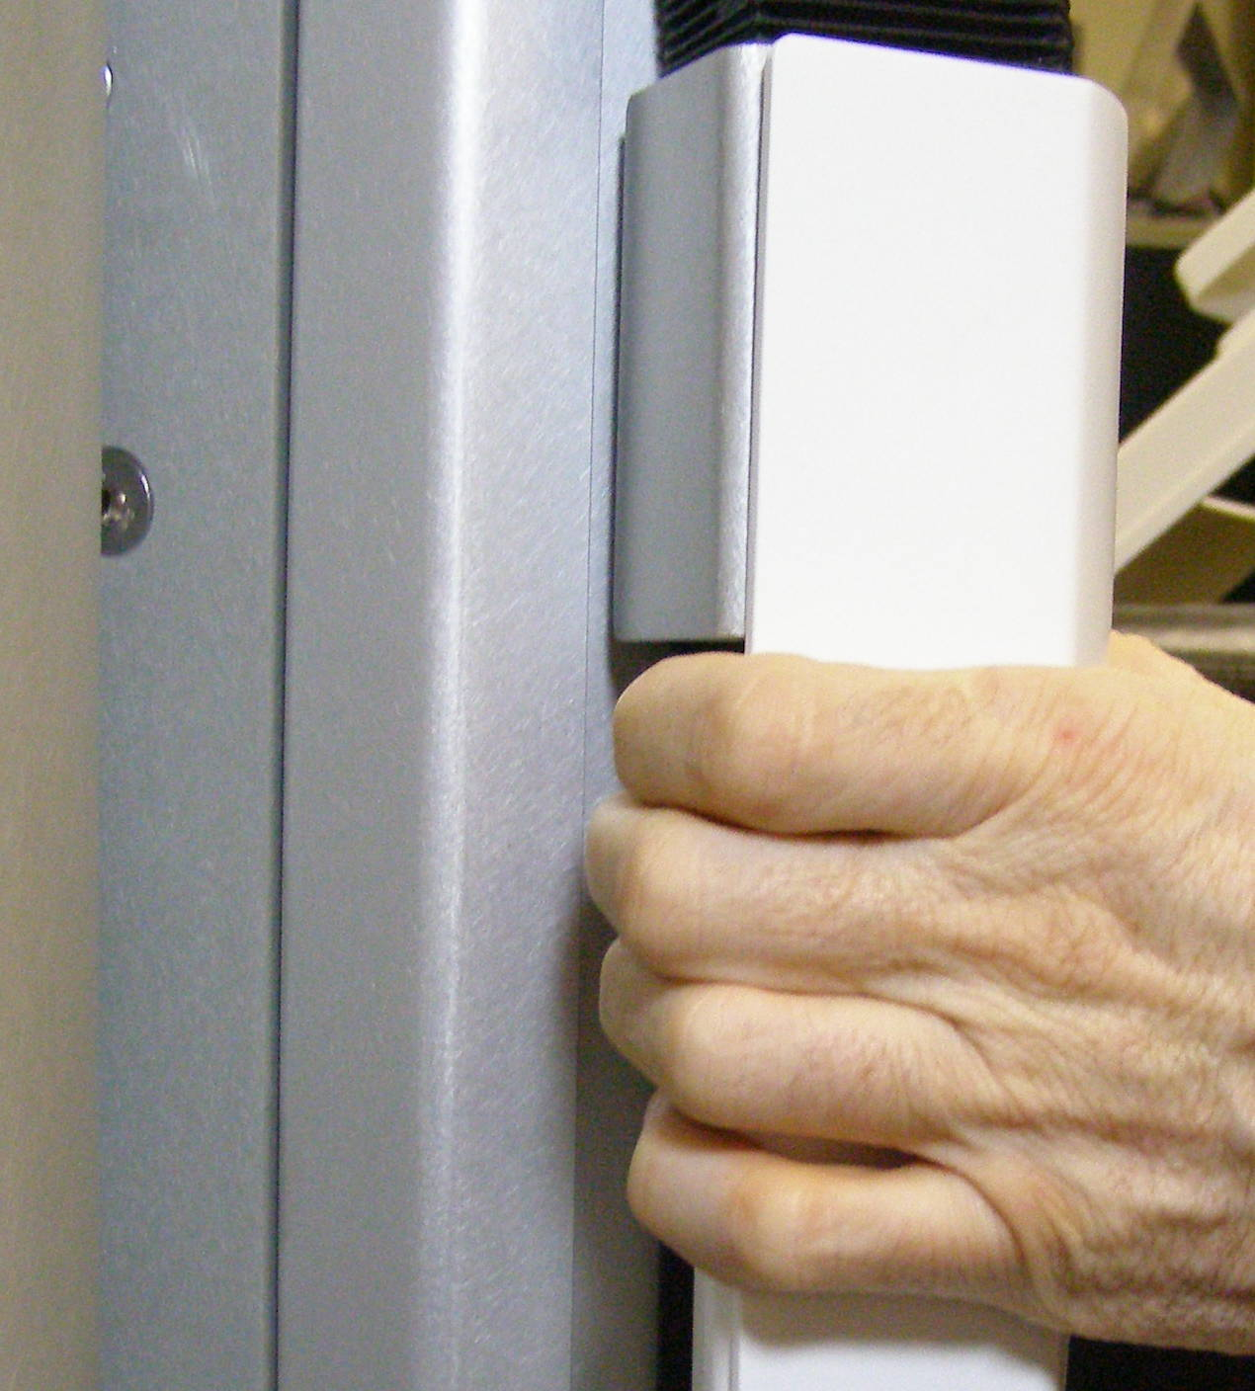
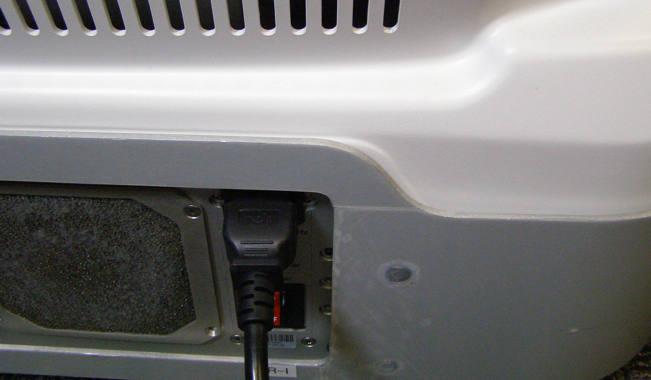
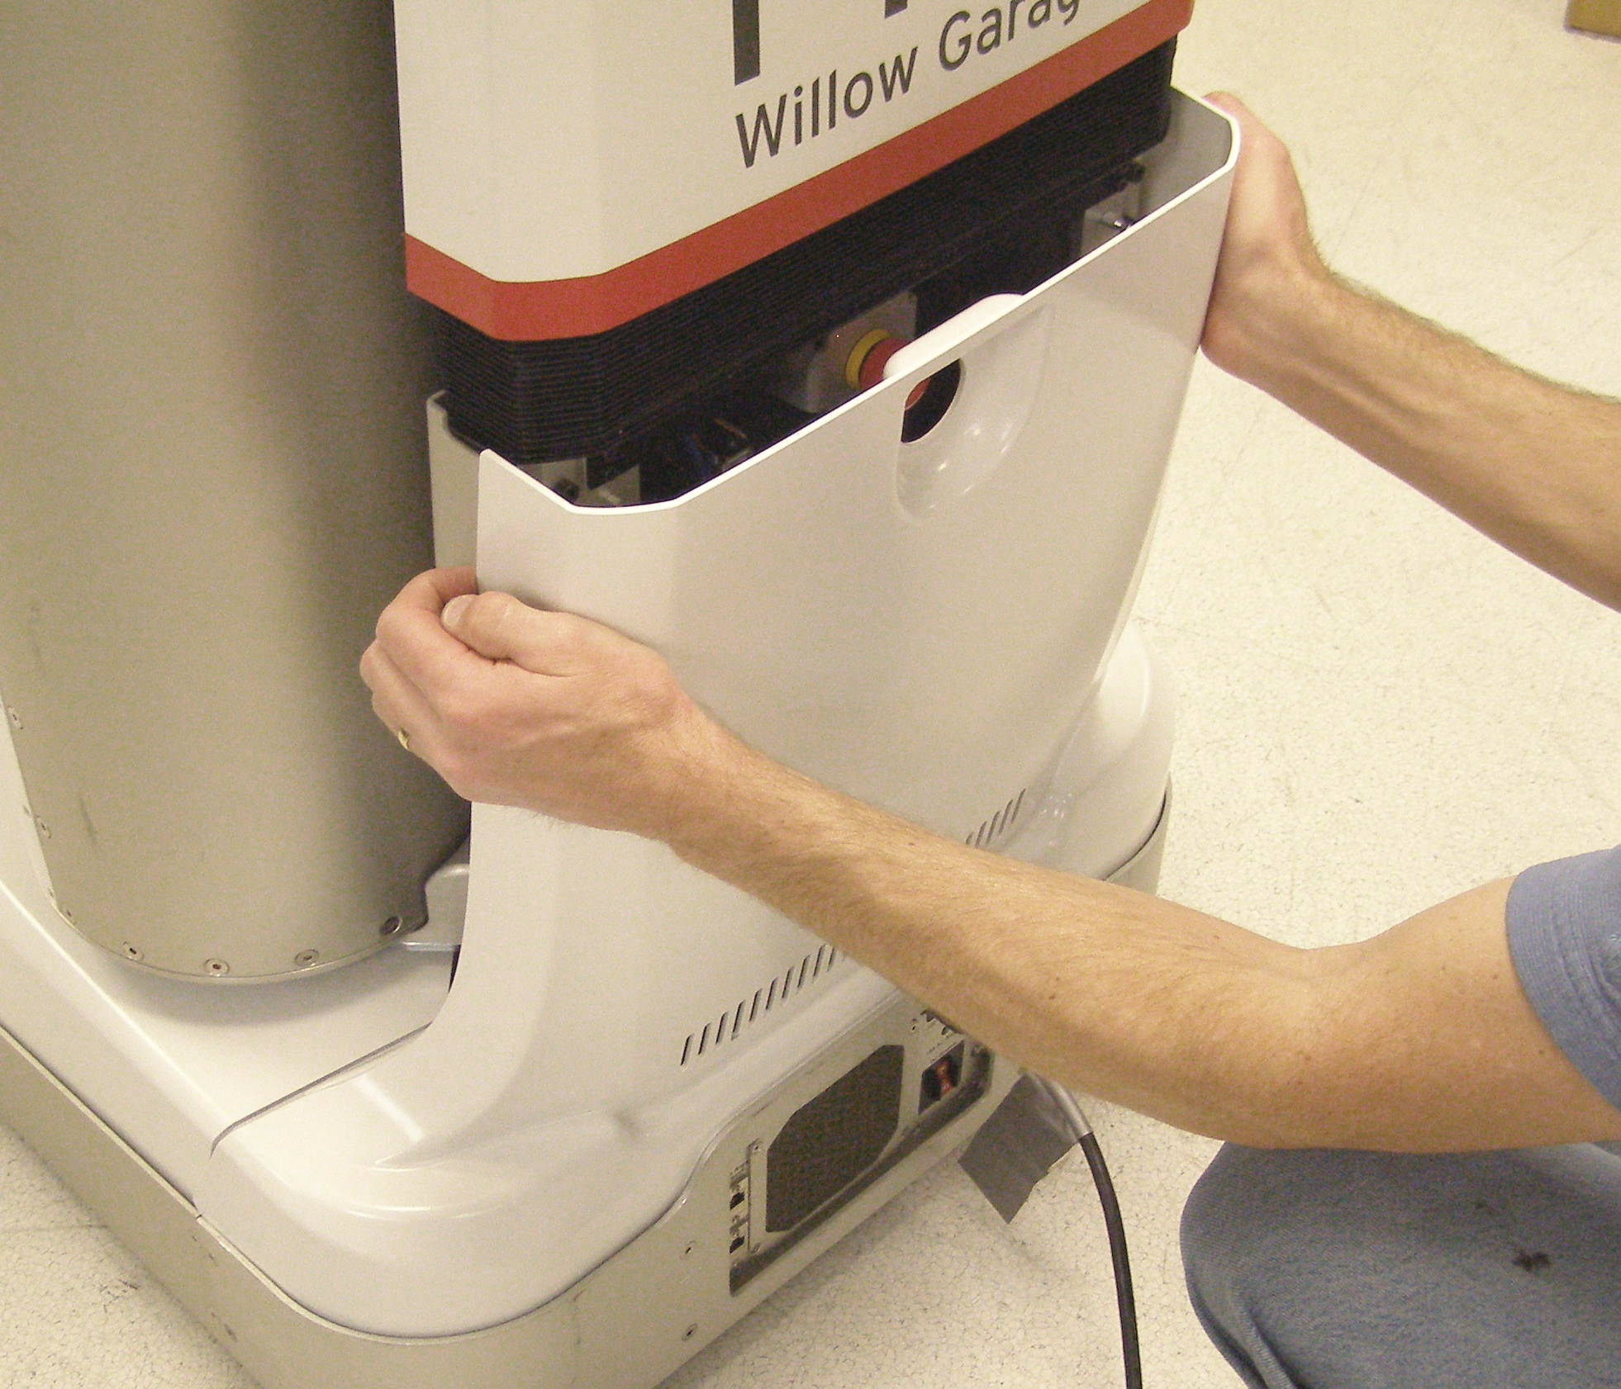
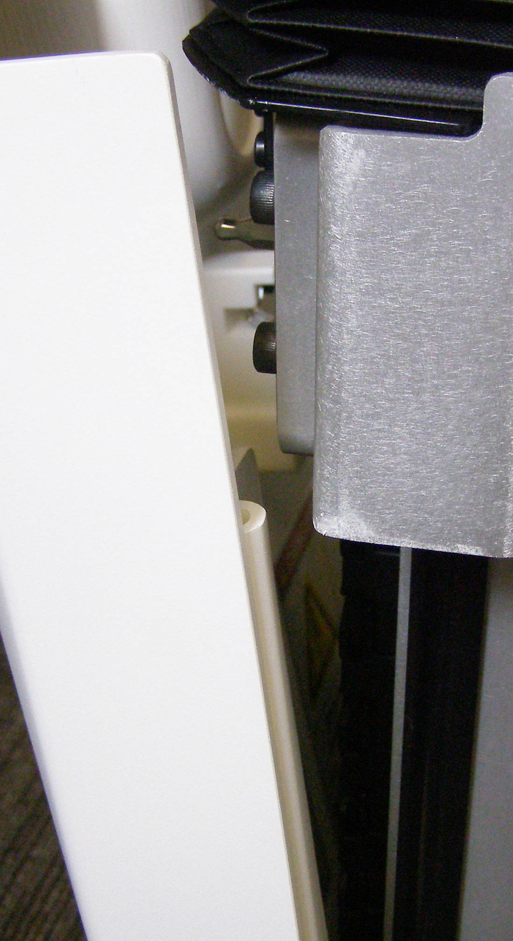
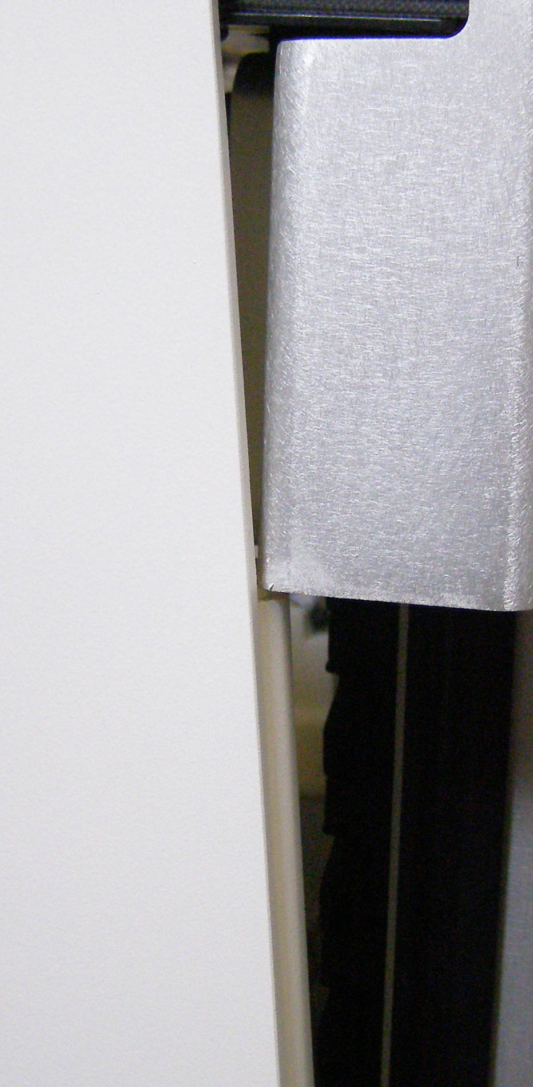
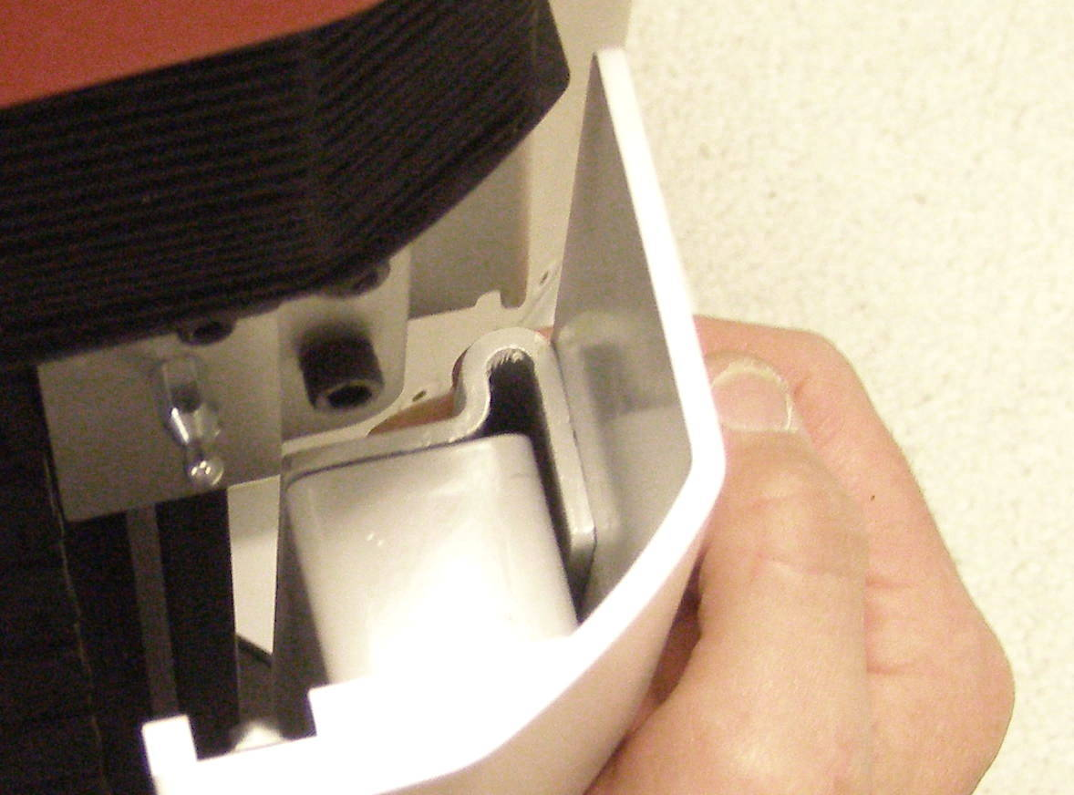
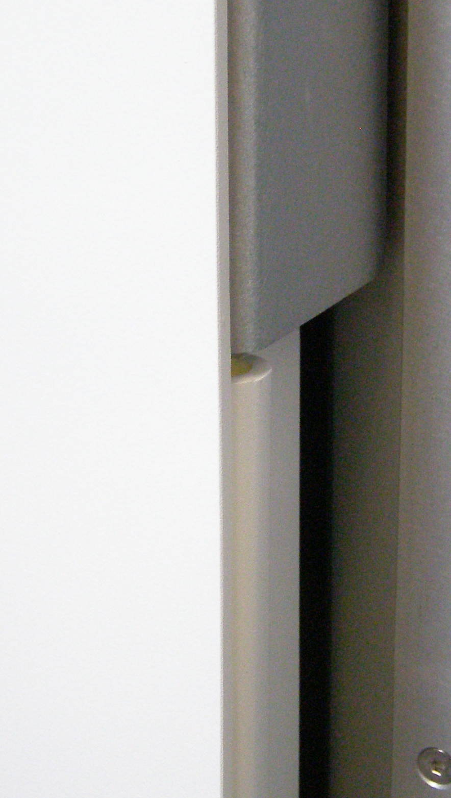
  Rear Bottom Panel R/R
Rear Bottom Panel, Removal - 2170
  Clasp the Panel on each side below the Aluminum boss. (Fig 1)
  Pull back firmly until the 2 snaps release. (Fig 2)
  Pull the top back until the Panel clears the Aluminum boss. (Fig 3,6)
  Lift the Panel up and out.
Rear Bottom Panel, Install
  Clasp the Panel on each side about in the middle.
  Insert the Panel into the base making sure it is all the way down. (Fig 4)
  Slowly move the Panel forward making sure it clears the Aluminum boss. (Fig 5,6)
  Continue pushing the top of the Panel forward until it snaps into place. (Fig 7)
Fig 1
Fig 4
Fig 2
Alum
boss
Fig 5
Fig 6
Fig 3
Fig 7

